Slide 1

STQA-Session 9
Black Box Testing (3)
Decision Table
chengbaolei@suda.edu.cn

Slide 2

Black Box Testing Techniques
• Boundary Value Analysis
• Equivalence Partitioning
• Decision Table
• Cause-Effect Graph
• Combinatorial Test

Slide 3
Black Box Testing Techniques
• Review
• Boundary Value Analysis
• Equivalence Partitioning
Motivation
Process
Application

Slide 4

Decision Table
A black-box test design technique in
which test cases are designed to execute the combinations of inputs.
Decision table is good for representing
and analyzing complex logical
relationships.

Slide 5
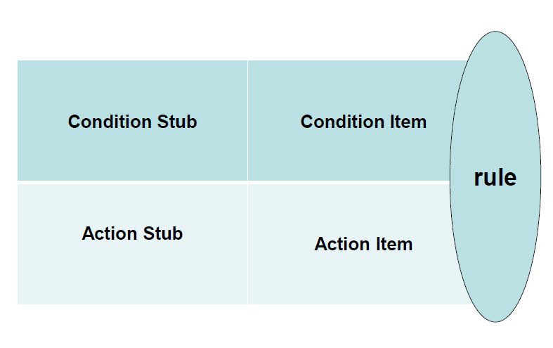
Decision Table Template

Slide 6
Decision Table
Limited entry decision table: All the
conditions are binary
Extended entry decision table:Conditions
are allowed to have several values
Mixed entry decision table

Slide 7
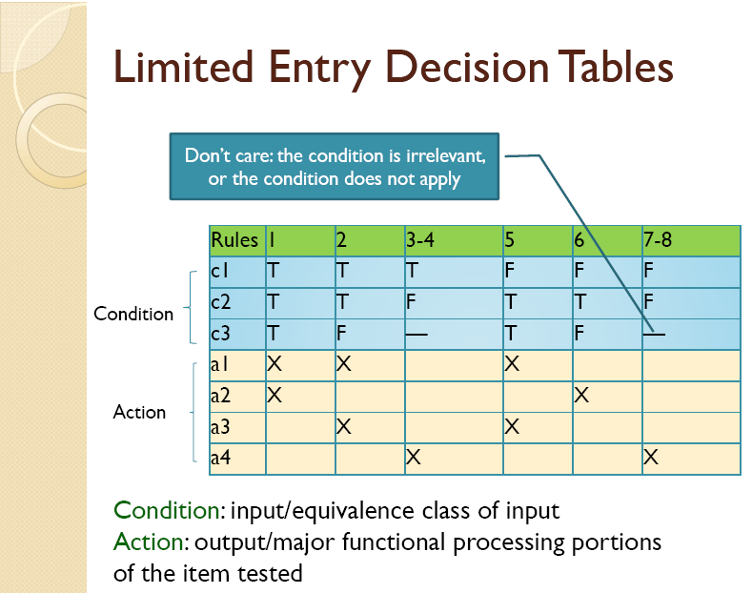

Slide 8
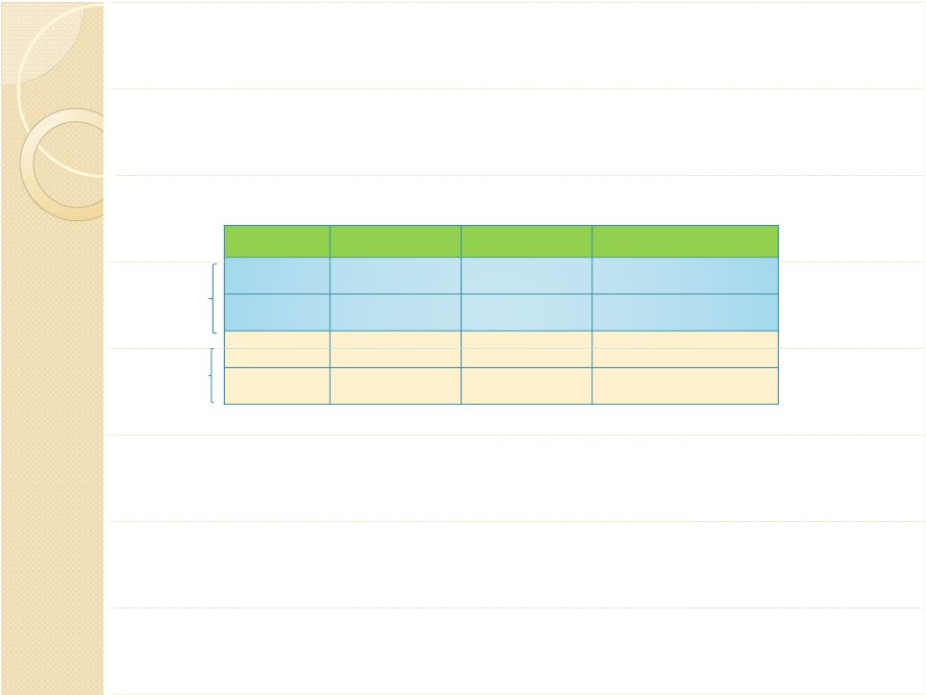
Extended Entry Decision Tables
Rules | 1 | 2 | 3
c1 | 0-10 | 0‐10 | 10‐100
c2 | <5 | 5 | >5
a1 | DoX | DoX | DoY
a2 | DoA | DoB | DoC
Condition
Action

Slide 9
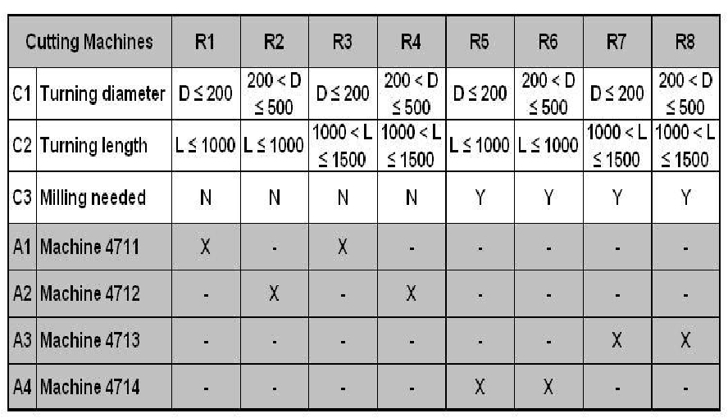
Mixed Entry Decision Tables

Slide 10
How to Make a Decision Table?
1. List all condition stubs and action stubs
2. Fill the condition items.
3. Fill the action items, make a initial table
4. Decision Table Verification

Slide 11
Decision Table Verification
Completeness
Combining
Redundancy
Inconsistence

Slide 12

Completeness of decision table
The decision table should contain every combination of
Predicate values
For limited entry decision tables, if n conditions exist,
there must be 2^{n} rules.
When don’t care entries really indicate that the
condition is irrelevant,we can develop a rule count as
follows:
• rules in which no don’t care entries occur count as
one rule
• each don’t care entry in a rule doubles the count of
that rule.
What about extended entry decision tables?

Slide 13
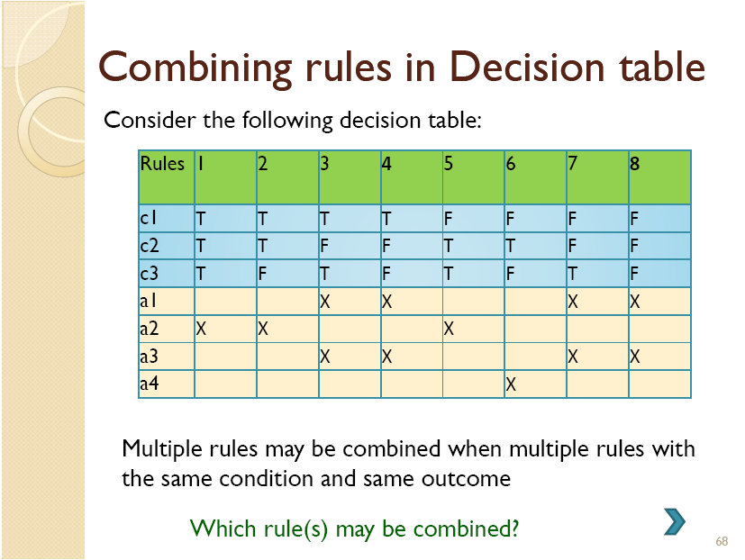
similar

Slide 14
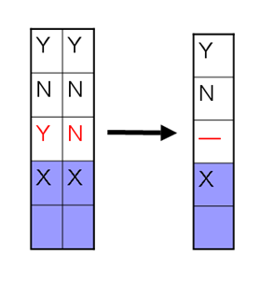
Rules | 1 | 2 | 3 | 4 | 5 | 6 | 7 | 8
c1 | T | T | T | T | F | F | F | F
c2 | T | T | F | F | T | T | F | F
c3 | T | F | T | F | T | F | T | F
a1 |  |  | X | X |  |  | X | X
a2 | X | X |  |  | X
a3 |  |  | X | X |  |  | X | X
a4 |  |  |  |  |  | X
Rules | 1 | 2 | 3‐4 | 5 | 6 | 7-8
c1 | T | T | T | F | F | F
c2 | T | T | F | T | T | F
c3 | T | F | ‐ | T | F | ‐
a1 |  |  | X |  |  | X
a2 | X | X |  | X
a3 |  |  | X |  |  | X
a4 |  |  |  |  | X
Rules | 1-2 | 3‐4, 7‐8 | 5 | 6
c1 | T | ‐ | F | F
c2 | T | F | T | T
c3 | - | ‐ | T | F
a1 |  | X
a2 | X |  | X
a3 |  | X
a4 |  |  |  | X
Check completeness
Other Contracted Decision Table?

Slide 15
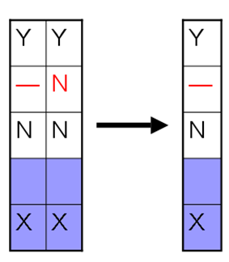
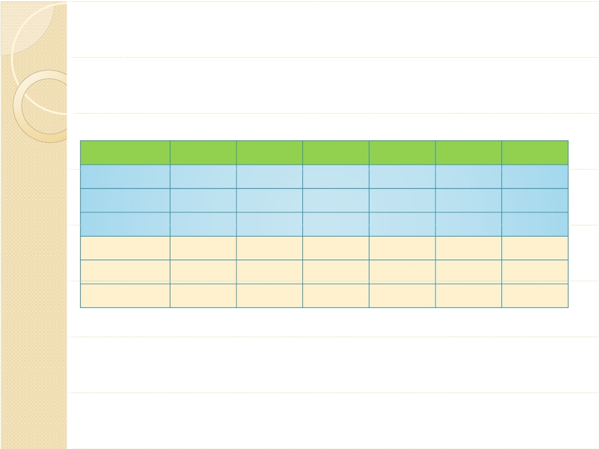
Redundant Decision Table
Stub | 1–4 | 5 | 6 | 7 | 8 | 9
c1 | T | F | F | F | F | T
c2 | — | T | T | F | F | F
c3 | — | T | F | T | F | F
a1 | X | X | X | — | — | X
a2 | — | X | X | X | — | —
a3 | X | — | X | X | X | X
What is the redundancy in this decision table?

Slide 16
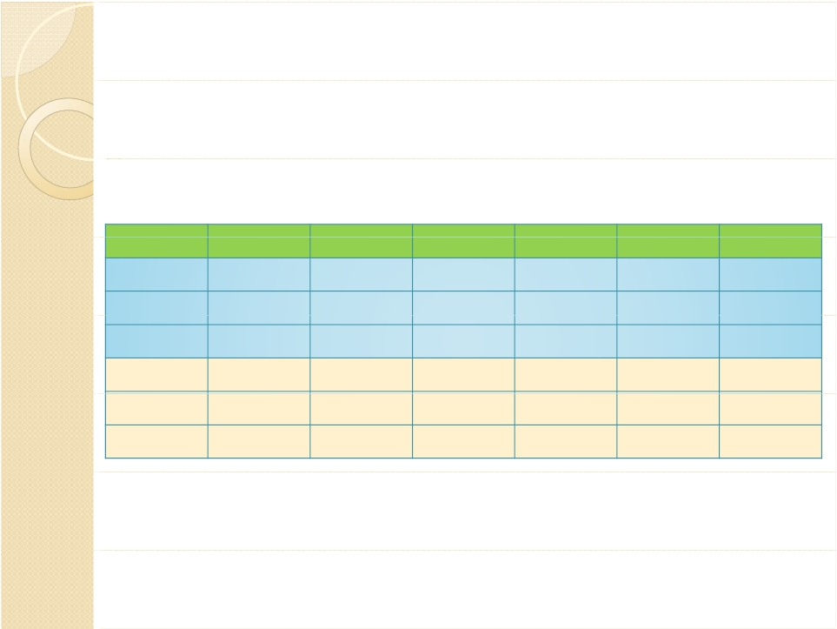
Inconsistent Decision Table
Every combination of predicate truth values results in
only one action or set of actions
Stub | 1–4 | 5 | 6 | 7 | 8 | 9
c1 | T | F | F | F | F | T
c2 | — | T | T | F | F | F
c3 | — | T | F | T | F | F
a1 | X | X | X | — | — | —
a2 | — | X | X | X | — | X
a3 | X | — | X | X | X | —
What is the problem of this decision table?

Slide 17
How to Make a Decision Table?
1. List all condition stubs and action stubs
2. Fill the condition items.
3. Fill the action items, make a initial table
4. Decision Table Verification
Completeness
Combining
Redundancy
Inconsistence

Slide 18
Examples
Triangle problem
NextDate problem

Slide 19
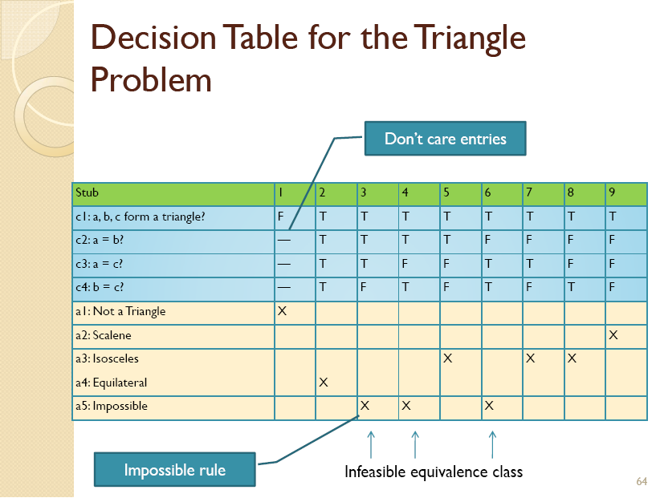
How many rules?
Based on EP results

Slide 20
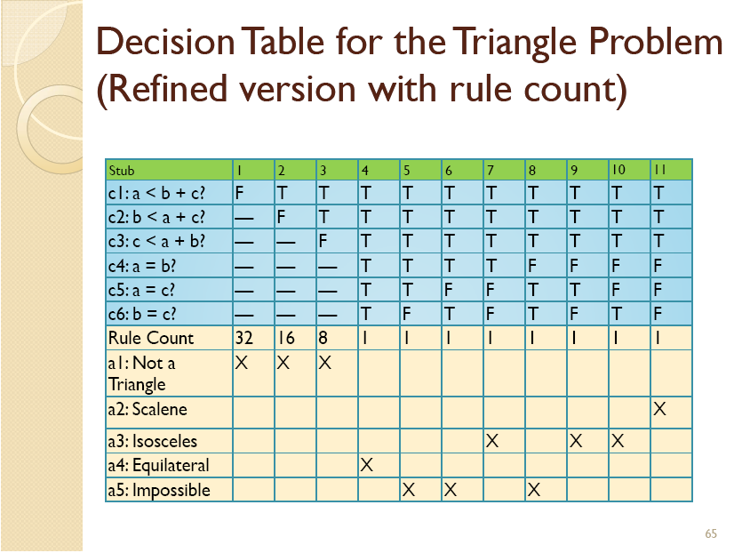

Slide 21
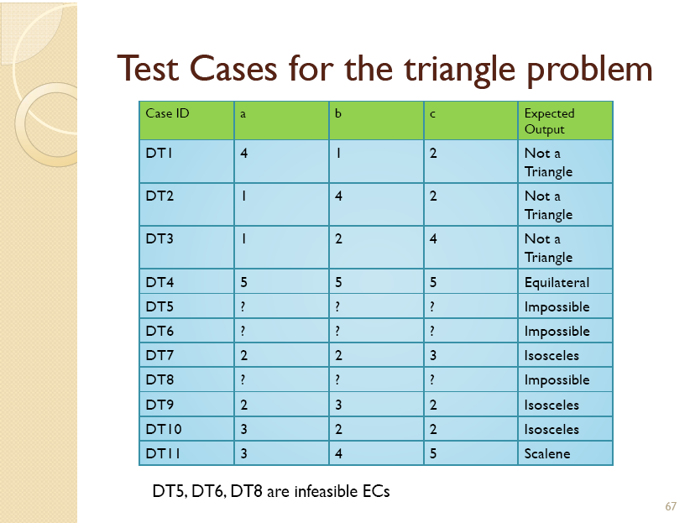

Slide 22
一个简单的练习
某公司的对客户分类标准如下：
顾客每次订货额在 1000元以上（含1000元），信誉好的，订单设“优先”标志；信誉不好，但是老客户的，订单设“优先”标志；信誉不好，但是新客户的，订单设“正常”标志；
每次订货额在 1000元以下，订单设“正常”标志。
请绘制相应的决策表。

Slide 23
一个简单的练习
 | 1 | 2 | 3 | 4
C1:订货额>=1000? | T | T | T | F
C2: 信誉好？ | T | F | F | -
C3: 老客户？ | - | T | F | -
# rules | 2 | 1 | 1 | 4
A1: 订单设“优先”标志 | X | X
A2: 订单设“正常”标志 |  |  | X | X

Slide 24

•
•
•
•
•
•
•
•
•
M1 = { month: month has 30 days}
M2 = { month: month has 31 days}
M3 = { month: month is February}
D1 = {day: 1<= day <= 28}
D2={day: day=29}
D3={day: day=30}
D4={day: day=31}
Y1={year: leap year}；
Y2={year: not leap year}.

Slide 25

•
•
•
•
•
•
A1: impossible day
A2: incremented day value
A3: date reset
A4: incremented month value
A5: month reset
A6: incremented year value

Slide 26

256 rules
Condition
C1: Is month in M1? C2: Is month in M2？ C3: Is month in M3？ C4: Is date in D1？ C5: Is date in D2？ C6: Is date in D3？ C7: Is date in D4？ C8: is year in Y1？ | T | T | T
A1: possible A2: NextDate
256 rules

Slide 27
Second trying: extended entry decision table + considering leap year 2000
Equivalent class set
M1={Month: 30 days}
M2={Month: 31 days}
M3={Month: February}
D1={Date: 1<=Date<=28}
D2={Date: Date=29}
D3={Date: Date=30}
D4={Date: Date=31}
Y1={Year: year=2000}
Y2={Year: is leap year and !=2000}
Y3={Year: is not leap year}

Slide 28
Second trying
 | 1 | 2 | 3 | 4 | 5 | 6 | 7 | 8
C1: month | M1 | M1 | M1 | M1 | M2 | M2 | M2 | M2
C2: date | D1 | D2 | D3 | D4 | D1 | D2 | D3 | D4
C3: year | - | - | - | - | - | - | - | -
# rules | 3 | 3 | 3 | 3 | 3 | 3 | 3 | 3
A1:impossible |  |  |  | X
A2:date++ | X | X |  |  | X | X | X
A3:date reset |  |  | X |  |  |  |  | X
A4:month++ |  |  | X |  |  |  |  | ?
A5:month reset |  |  |  |  |  |  |  | ?
A6:year++ |  |  |  |  |  |  |  | ?
Extended entry decision table
3*4*3=36rules

Slide 29
Second trying (continued)
 | 9 | 10 | 11 | 12 | 13 | 15 | 15 | 16
C1: month | M3 | M3 | M3 | M3 | M3 | M3 | M3 | M3
C2: date | D1 | D1 | D1 | D2 | D2 | D2 | D3 | D4
C3: year | Y1 | Y2 | Y3 | Y1 | Y2 | Y3 | - | -
# rules | 1 | 1 | 1 | 1 | 1 | 1 | 3 | 3
A1:impossible |  |  |  |  |  | X | X | X
A2:date++ | X | X
A3:date reset |  |  | X | X | X
A4:month++ |  |  | X | X | X
A5:month reset
A6:year++

Slide 30
Third trying: consider date and month
Equivalent class set
M1={Month: 30 days}
M2={Month: 31 days, except December}
M3={Month: December}
M4={Month: February}
D1={Date: 1<=Date<=27}
D2= {Date: Date=28}
D3={Date: Date=29}
D4={Date: Date=30}
D5={Date: Date=31}
Y1={Year: is leap year}
Y2={Year: is not leap year}
How many rules?

Slide 31
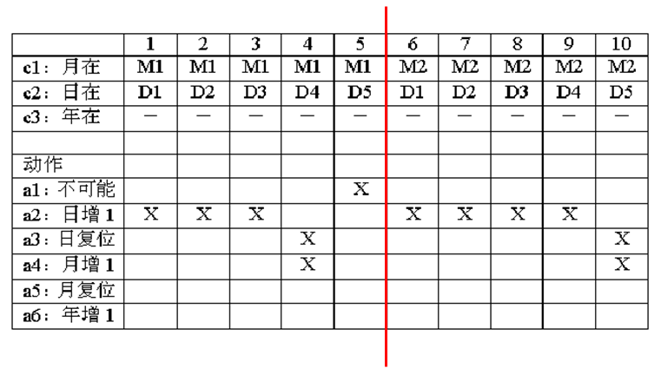
Decision Table for NextDate

Slide 32
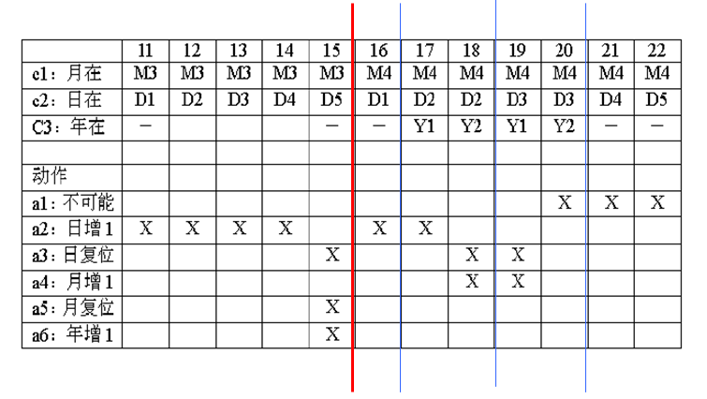
Decision Table for NextDate (continued)

Slide 33
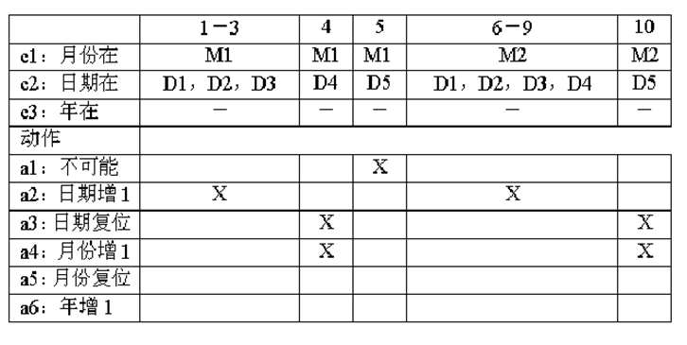
Simplified Decision Table for NextDate

Slide 34
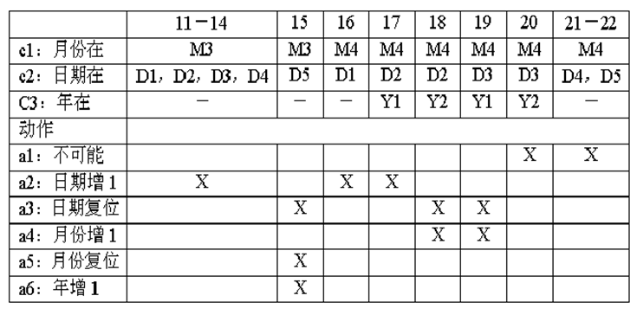
Simplified Decision Table for NextDate (continued)

Slide 35
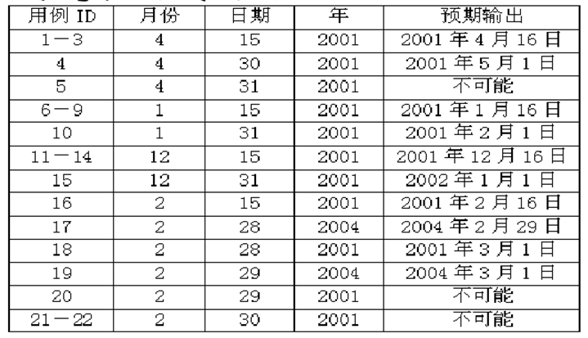
13 Test cases of NextDate

Slide 36
Exercise (consider from another point)
Equivalent class set
D1={Date: 1<=Date<=27}
D2= {Date: Date=28}
D3={Date: Date=29}
D4={Date: Date=30}
D5={Date: Date=31}
M1={Month: 30 days}
M2={Month: 31 days, except December}
M3={Month: December}
M4={Month: February}
Y1={Year: is leap year}
Y2={Year: is not leap year}

Slide 37
13 Test cases of NextDate
 | 1 | 2 | 3 | 4 | 5 | 6 | 7 | 8 | 9 | 10 | 11 | 12 | 13
C1:date | D1 | D2 | D2 | D2 | D3 | D3 | D3 | D4 | D4 | D4 | D5 | D5 | D5
C2:month | - | M1,M2,M3 | M4 | M4 | M1,M2,M3 | M4 | M4 | M1 | M2,M3 | M4 | M1,M4 | M2 | M4
C3:year | - | - | Y1 | Y2 | - | Y1 | Y2 | - | - | - | - | - | -
A1: impossible |  |  |  |  |  |  | X |  |  | X | X
A2:date++ | X | X | X |  | X |  |  |  | X
A3:date reset |  |  |  | X |  | X |  | X |  |  |  | X | X
A4:month++ |  |  |  | X |  | X |  | X |  |  |  | X
A5:month reset |  |  |  |  |  |  |  |  |  |  |  |  | X
A6:year++ |  |  |  |  |  |  |  |  |  |  |  |  | X

Slide 38
BVA VS. EP VS. DT
边界值分析 基于取值域，不识别数据或逻辑关系； 很容易自动化实现，设计工作量小； 生成的测试用例数比较多，测试用例执行时间长。
等价类技术 考虑数据依赖关系，标识等价类时需要更多的判断和技巧； 等价类标识出以后的处理也是机械的； 设计工作量和测试用例数属中等。
决策表技术 考虑数据的逻辑依赖关系； 所得测试用例可以是完备的，测试数量在一定意义上讲是最少的； 需要通过多次迭代，设计工作量很大。

Slide 39
Black Box Testing Techniques
• Boundary Value Analysis
• Equivalence Partitioning
• Decision Table
• Cause-Effect Graph
• Combinatorial Test

